Slide 1

Project Title: DISTANCE MEASUREMENT SYSTEM -TAPLESS MEASUREMENT
Student Names: B Leela surya kumari, B Saraswathi, R Indu Priya, S Likhitha
Roll Numbers: 24K61A1407, 24K61A1410, 24K61A1447, 24K61A1452
Department: Electronics and Communication Technology
Guide/Mentor: Mr.P. Praveen & Mrs. N. Kusuma

Slide 2
Introduction
A tapeless distance measurement system is used to measure the distance between the sensor and an object without using a measuring tape. It uses an HC-SR04 ultrasonic sensor and an Arduino UNO to calculate the distance by measuring the time taken for the sound wave to return. The measured distance is displayed on an LCD screen, providing a fast, accurate, and contactless measurement solution.

Slide 3
Problem statement
Traditional distance measurement using measuring tapes is time-consuming, requires physical contact, and may be unsafe in certain environments. There is a need for a fast, accurate, and contactless distance measurement system. This project uses an ultrasonic sensor and Arduino UNO to measure distance and display the result in real time on an LCD screen.

Slide 4
Objectives
Measure distance without using a measuring tape.
Reduce human error.
Display the measured distance instantly.
Build a simple and low-cost measuring system.

Slide 5
Scope of the Project
Provides fast and contactless distance measurement.
Can be used in robotics, parking systems, and water level monitoring.
Suitable for educational, industrial, and home automation applications.
Can be enhanced by adding Wi-Fi, IoT, data logging, or mobile app support.

Slide 6
Limitations of the Project
Measurement accuracy decreases with soft or irregular surfaces.
Limited to the operating range of the ultrasonic sensor (typically 2 cm to 400 cm for HC-SR04).
Environmental factors such as temperature and humidity can affect accuracy.
Cannot measure distance accurately if there are multiple obstacles or highly absorbent materials in the sound path.

Slide 7
Existing System
Uses measuring tape or ruler.
Requires manual operation.
Time-consuming.
Less convenient for inaccessible areas.
Chances of human error.

Slide 8
Components
Hardware
Arduino UNO
Ultrasonic Sensor (HC-SR04)
16 x 2 LCD Display
Embedded C Tools and Technologies Used
Software
Wokwi Simulator
Arduino IDE
Programming Language
Arduino C/C++

Slide 9
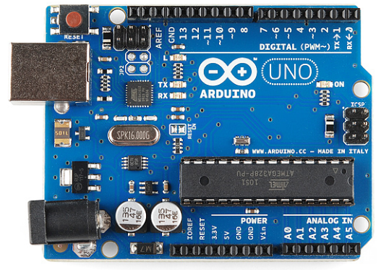
Arduino UNO
Arduino UNO is a microcontroller board that acts as the brain of the system.
It processes signals from the ultrasonic sensor and calculates the distance.
It controls the display and overall operation of the system.

Slide 10
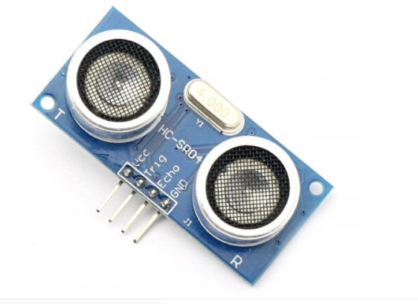
Ultrasonic Sensor
An ultrasonic sensor measures the distance to an object by sending ultrasonic sound waves and receiving the reflected echo.
It provides fast, accurate, and contactless distance measurement and is widely used in robotics, parking systems, and water level monitoring.

Slide 11
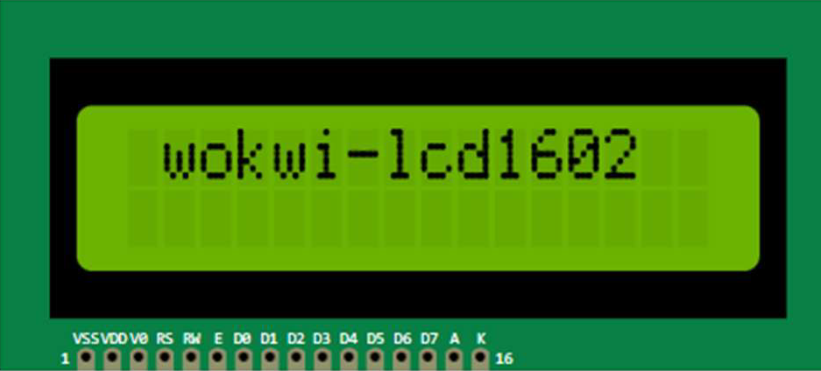
16 x 2 LCD Display
A 16×2 LCD is a display module that can show 16 characters in each of its 2 rows, making it useful for displaying text and numbers.
It is commonly used with Arduino to display information such as distance, temperature, sensor readings, and system status.

Slide 12
Connections
Arduino UNO to Ultrasonic Sensor (HC-SR04):
VCC → 5V
GND → GND
TRIG → Digital Pin 9
ECHO → Digital Pin 10
Arduino UNO to 16×2 LCD Display (I2C):
VCC → 5V
GND → GND
SDA → A4
SCL → A5

Slide 13
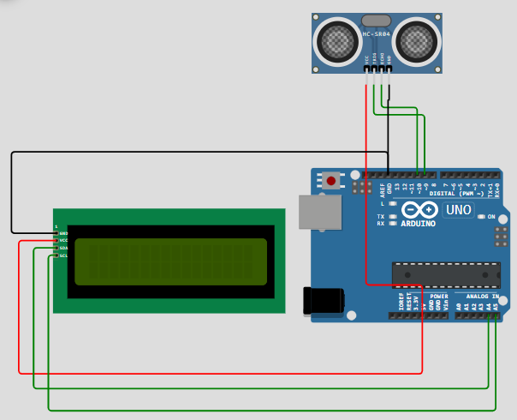
Circuit

Slide 14
Working principle
The Arduino UNO sends a signal to the ultrasonic sensor through the TRIG pin.
The sensor emits ultrasonic sound waves, which reflect back after hitting an object.
The ECHO pin receives the reflected waves, and Arduino calculates the distance using the travel time.
The measured distance is displayed on the 16×2 LCD.
This process repeats continuously, providing real-time, contactless distance measurement.

Slide 15
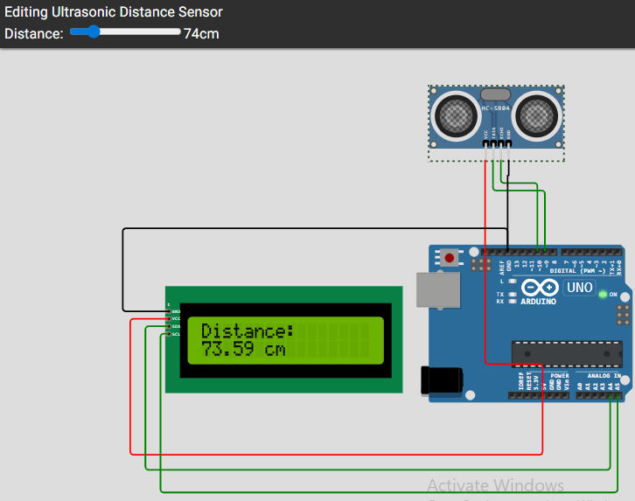
Output & Test cases
The LCD displays the distance between the sensor and the object in centimeters. The readings update continuously in real-time.

Slide 16
Advantages
Contactless measurement
Fast response
Good accuracy
Easy to use
Low cost
Portable

Slide 17
Applications
Robotics – Obstacle detection and navigation.
Water tank level monitoring – Measures water level without contact.
Parking assistance – Detects the distance between vehicles and obstacles.
Industrial automation – Measures object distance in production lines.
Smart home systems – Used in automatic doors and security systems

Slide 18
Future Scope
Add Wi-Fi for remote monitoring.
Store measurement data.
Connect to a mobile application.
Add buzzer alerts.
Improve measurement range.

Slide 19
References
Arduino Uno Documentation
Wokwi Simulator
Arduino IDE Documentation
Embedded Systems Reference Material

Slide 20
Conclusion
The tapeless distance measurement system accurately measures distance without physical contact using an ultrasonic sensor and Arduino UNO.
It provides fast, reliable, and real-time distance measurement, making it more efficient than traditional methods.

Slide 21
THANK YOU

